Slide 1

Renting Flats in Wrocław Selection Criteria
Prepared by: ADRIANA NAUMCZUK, JOANNA STAWIK, CATALINA AYA
PRESCRIPTIVE ANALYTICS.

Slide 2

Selection of Criteria
38 VARIABLES
Street
Neighbourhood
District
Construction Status
FLATS TO RENT IN WROCŁAW
scrapped from otodom.pl website
Area
Rent
No. Rooms
Deposit
Floor
Building Type
Balcony
Price
Garden
Alarm System
Heating
Garage Parking

Slide 3

Dataset
979 FLATS
Link | District | Price | Area | Price_Trans | District_val | Choice | Class(Binary)
https://www.otodom.pl/pl/oferta/pokoj-w-centrum-ID4n6Q6 | Psie Pole | 1100 | 65,00 | 2400 | 50 | N | 0
https://www.otodom.pl/pl/oferta/pokoje-do-wynajecia-w-mieszkaniu-dwupokojowym-ID4nQ8r | Srodmiescie | 1500 | 48,50 | 2000 | 90 | Y | 1
https://www.otodom.pl/pl/oferta/dwa-pokoje-klimatyzacja-ul-pereca-ID4oA6t | Fabryczna | 1900 | 52,00 | 1600 | 60 | Y | 1
https://www.otodom.pl/pl/oferta/duze-studio-40m-osobna-sypialnia-ul-augustowska-ID34dzU | Fabryczna | 1950 | 40,00 | 1550 | 60 | Y | 1
https://www.otodom.pl/pl/oferta/wynajme-50-mkw-2-pokoje-wroclaw-srodmiescie-ID48xvk | Srodmiescie | 2100 | 50,00 | 1400 | 90 | Y | 1
https://www.otodom.pl/pl/oferta/dwupokojowe-sloneczne-40m2-centrum-ID3DJaY | Srodmiescie | 2100 | 40,00 | 1400 | 90 | Y | 1
https://www.otodom.pl/pl/oferta/2pok-45-m2-ul-czackiego-srodmiescie-parking-ID4ot4J | Srodmiescie | 2200 | 45,00 | 1300 | 90 | Y | 1
https://www.otodom.pl/pl/oferta/2-pokoje-osobna-kuchnia-pierwszy-najem-ID4oMOV | Fabryczna | 2300 | 47,00 | 1200 | 60 | N | 0
https://www.otodom.pl/pl/oferta/2-oddzielne-pokoje-biskupin-ua-ID4oJHk | Srodmiescie | 2400 | 47,00 | 1100 | 90 | Y | 1
https://www.otodom.pl/pl/oferta/2-pok-balkon-garaz-ogrody-hallera-ID4oQeX | Fabryczna | 2600 | 40,00 | 900 | 60
https://www.otodom.pl/pl/oferta/2-pok-balkon-komorka-lok-kukuczki-8-ID4oNW4 | Krzyki | 2400 | 40,00 | 1100 | 70
https://www.otodom.pl/pl/oferta/2-pok-balkon-ogrzew-miejskie-kolo-fatu-ID4oEMu | Fabryczna | 2300 | 40,00 | 1200 | 60

Slide 4


Data Transformation
District | Value
Stare Miasto | 80
Środmiescie | 90
Krzyki | 70
Siechnice | 25
Kobierzyce | 20
Fabryczna | 60
Psie Pole | 50
Price
Area
District
Notes:
Prices are transformed, the max price was 3500 - now after transformation is 0.
Max price - current price = transformed price
And then we want to maximize transformed price.

Slide 5

Training Data
33 FLATS
Testing Data
946 FLATS

Slide 6

Problem
OVERWHELMING NUMBER OF FLAT RENTAL OPTIONS IN WROCŁAW MAKES EFFICIENT SELECTION DIFFICULT.
IDENTIFY A SHORTLIST OF THE MOST PROMISING OPTIONS BASED ON PERSONAL PREFERENCES.THE
Objective
Benefits
SAVE TIME AND EFFORT BY FOCUSING ON SHORTLISTED FLATS.
INCREASE CHANCES OF FINDING A PERFECT FIT BY PRIORITIZING PREFERENCES.
MAKE INFORMED DECISIONS BASED ON PERSONAL PRIORITIES.

Slide 7

Treshold
Accepted
Rejected
0.4990
309 FLATS
637 FLATS
Area | Price | District | Utility | Decision
40 | 700 | 50 | -1.85037170770860e-17 | 0
40 | 1200 | 60 | 0.345108695652174 | 0
40 | 900 | 80 | 0.586956521739131 | 1
40 | 1200 | 60 | 0.345108695652174 | 0
40 | 910 | 80 | 0.593478260869565 | 1
40 | 770 | 60 | 0.0646739130434783 | 0
40 | 700 | 80 | 0.500000000000000 | 1
40 | 790 | 80 | 0.515217391304348 | 1

Slide 8

Optimal Solution
0.0313
Model Accuracy
SMALL DEVIATION INDICATES A HIGH ACCURACY IN THE UTILITY FUNCTION ESTIMATION FOR THE TRAINING DATA. MODEL IS EFFECTIVELY CAPTURING THE RELATIONSHIPS BETWEEN THE CRITERIA (AREA, PRICE, AND DISTRICT) AND THE OVERALL UTILITY.
Model Validity
LOW DEVIATION SUPPORTS THAT THE TRANSFORMATION AND THE APPLIED METHODOLOGY ARE VALID FOR THE GIVEN DATA.

Slide 9

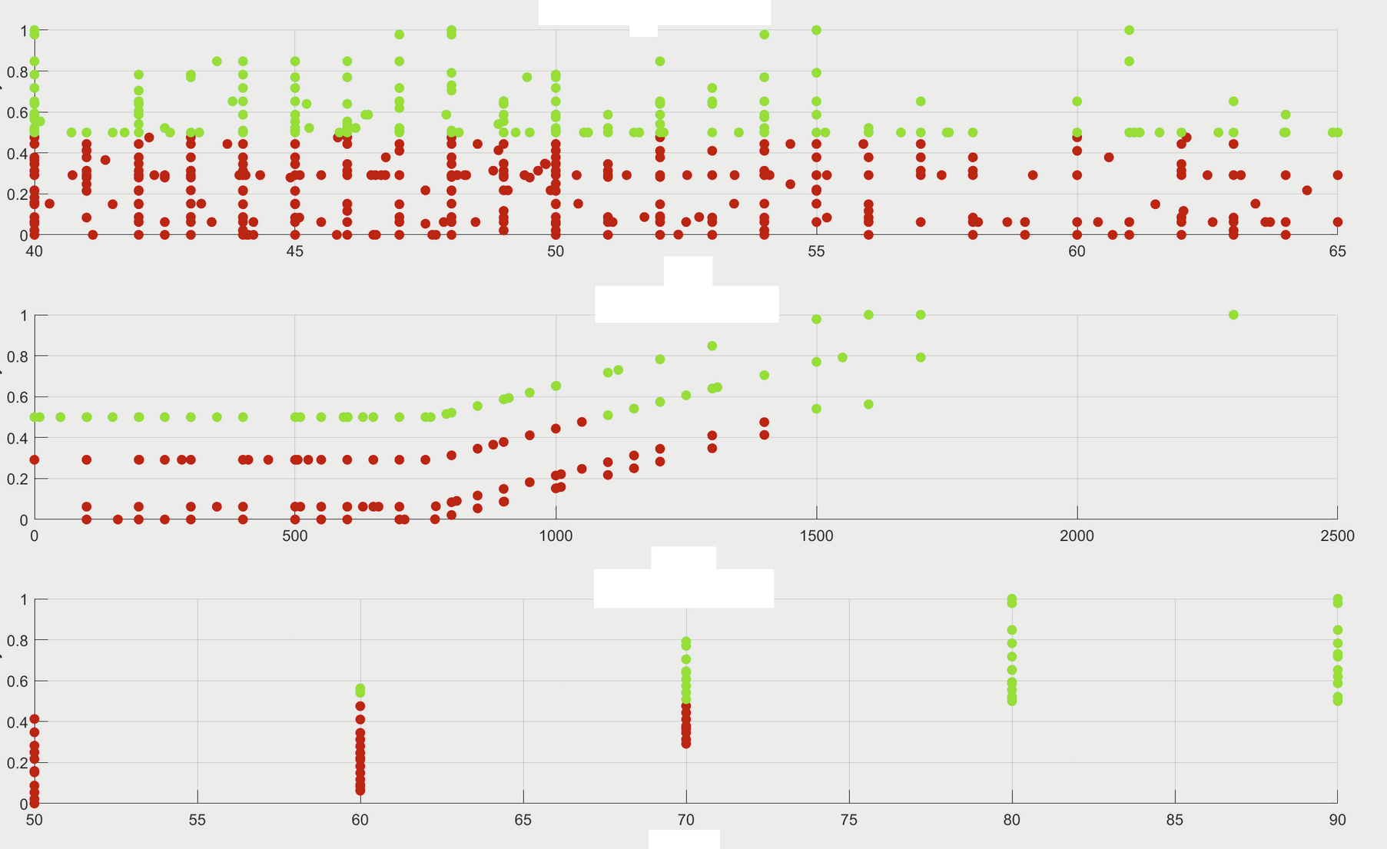
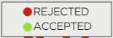
AREA (C1)
OVERALL UTILITY
PRICE (C2)
DISTRICT (C3)

Slide 10
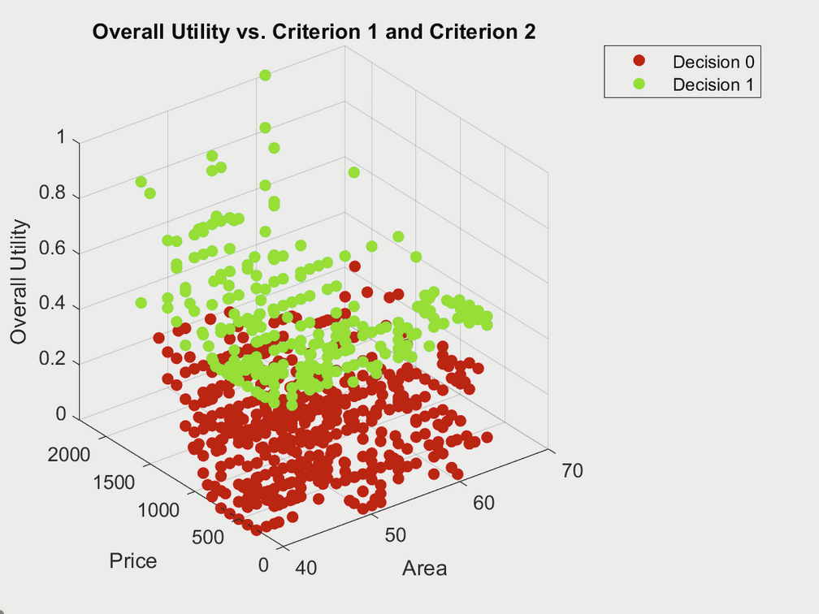
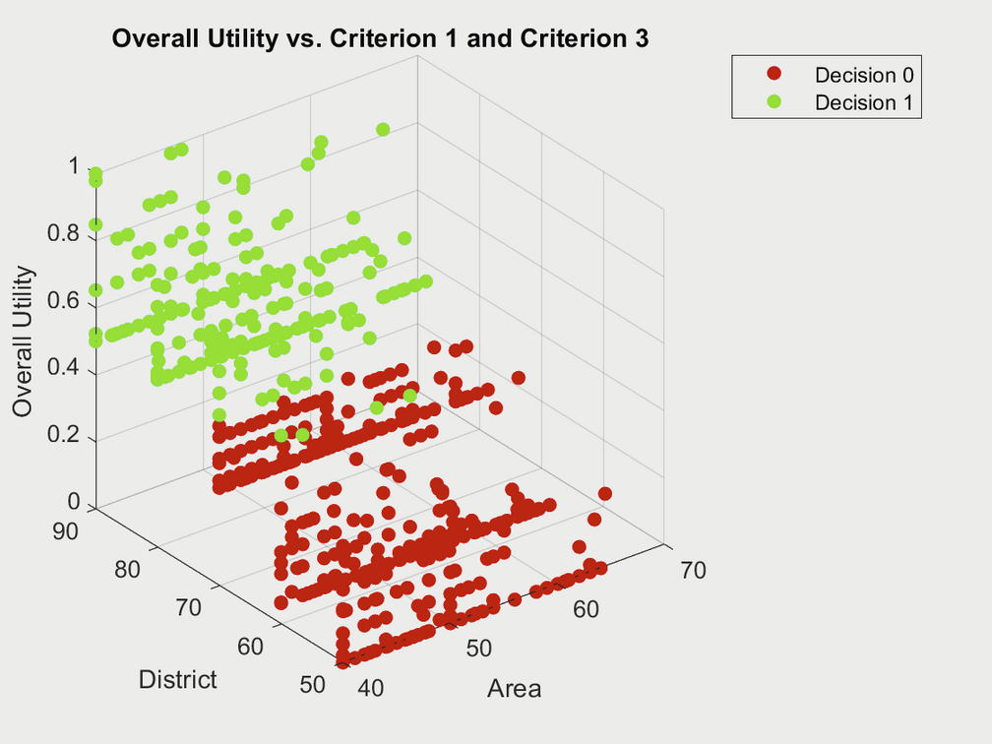
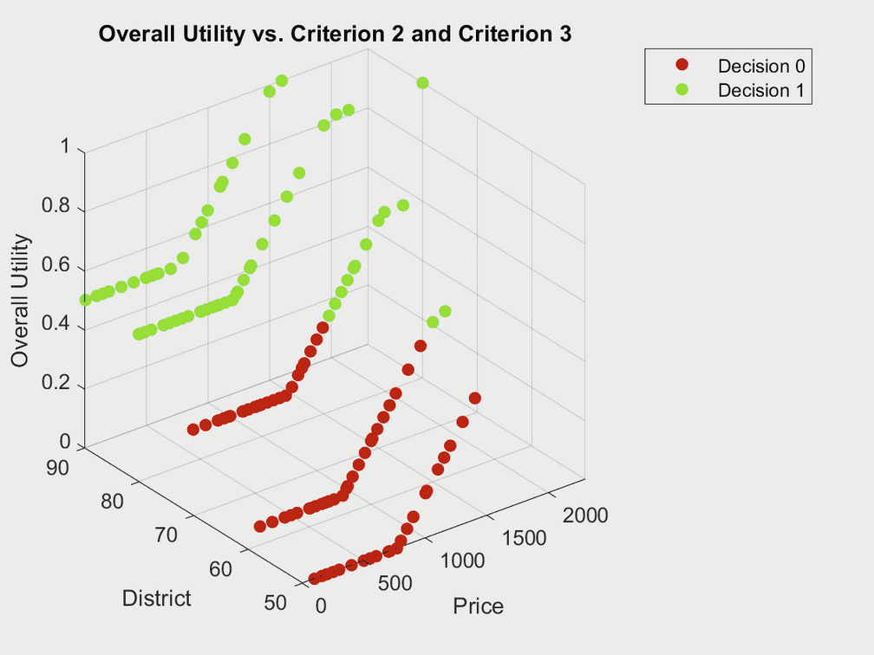


Slide 11

Thank you!
Questions?
Prepared by: ADRIANA NAUMCZUK, JOANNA STAWIK, CATALINA AYA
PRESCRIPTIVE ANALYTICS.

